Slide 1
Apache Pig

Slide 2
What is Pig ?
A High Level data flow language
Best for analyzing Large datasets
Geared for parallel processing
Compiler produces a sequence of MR programs (in –x mapreduce)
Operates on files on Local machine/HDFS
Metadata is not required, but can be used when available (HCatlog)
Optimal tool for semi-structured data/ETL needs on Hadoop
Can also be run on Tez & Spark

Slide 3
Why Pig ?
Pig follows multi-query approach, which helps combine multiple operation together and hence reducing the number of scans on data
Its simple and concise: 1/20th the lines of code and 1/16th the dev time compared to MapReduce
This Pig eats anything: Structured, Semi-Structured and UnStructured. It adds the complex data-types like Bags, Tuples etc., missing in MR
Its inherently Lazy! – hence can produce efficient execution plan
Sampling in any use case. Ex: Data Profiling
Functionalities can be easily extended through UDFs – including Python, Java, Ruby etc.,

Slide 4
Pig v/s Hive
Hive is SQL like; Pig too – but not really! It’s a procedural language
Pig is used for data analysis and not mainly for creating reports and dashboards like Hive
They have similar execution times +/- 25% variance
Pig doesn’t need/doesn’t have a dedicated metastore unlike Hive. However, it could use one when available.
Pig operates on client side - Hive on server side
Pig doesn’t support partitions – Hive does
Pig doesn’t support ODBC/JDBC – Hive does
* If you’re good at SQL; chances are you’ll not use Pig unless needed to ETL unstructured data
Notes:
Pig doesn’t do control structures inherently, but the same can be accomplished using pig scripts in Python or Java programs
Pig supports defining and importing Macros
Pig has COGROUP ~ OUTER join; Hive doesnt

Slide 5
COMPLEX Datatypes
BAG is collection of TUPLES ~ Tables in our world. Interchangeably called as a RELATION. Ex: ((Amar, 30, M) ,(Vinay, 25, M))
A TUPLE is an ordered set. Ex: (name, age, sex)
A FIELD is a piece of data. Ex: `name`
And then there is MAP. Ex: [‘Name’ # ‘Joydeep’]
In PIG, Null is UNKNOWN or NON-EXISTENT, similar to SQL though
There is no string or char; its CHARARRAY
Notes:
Datetime is recently added
Storage vise: PigStorage() is native; also supports custom formats like Avro, JSON etc for LOAD and STORE

Slide 6
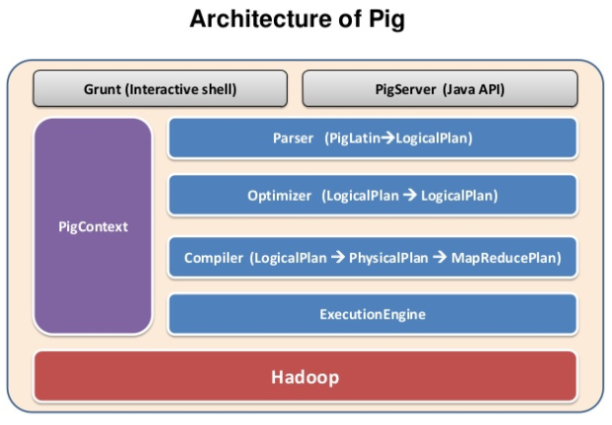

Slide 7
Starting PIG
MapReduce: >pig or >pig –x mapreduce
Local: >pig –x local
Tez: >pig –x tez
Spark: >pig –x spark. 1)doesn’t make sense 2)still not completely available
You should see grunt> shell

Slide 9
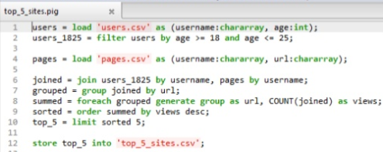
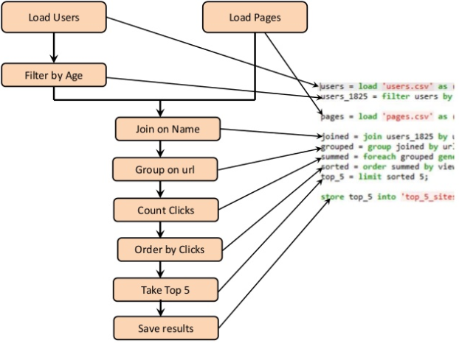
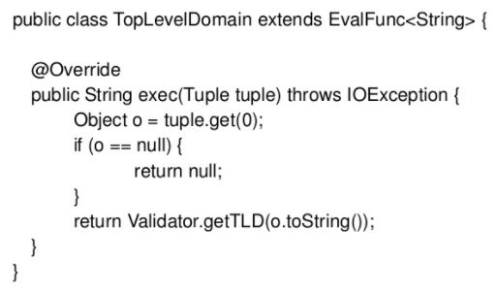

Slide 10
